Slide 1
Oracle Financials
IA Comprehension Survey
Toshiba Information Equipment Phils.,Inc.
2023.07.24
Scope of Disclosure | within TIP only
Head of Information Owner Section | TIP

Slide 2
Outline
What is IA System?
Feature of system
System Overview
Function Overview

Slide 3
What is IA System?
IA System (Inventory Accounting System) is a self-made Cost Accounting System. It tracks transactions, calculates daily costs with Inventory Management, and offers up-to-date sub-ledger reports. Using it cuts down on monthly closing workloads.

Slide 4
System Overview
Handling IA on PRAS
IA program storage location
：/mprs3ADD/applprs3/prsappl/xxia
IA database table location schema
：XXIA

Slide 5
Feature of system
Price Management
Transaction Management
Reports Management

Slide 6
Price Management
The Price Master typically includes the pricing information for each item, such as its cost, selling price, markup percentage, and other relevant pricing details.
Cost price is managed at each inventory organization.

Slide 7
The Four types of pricing
Price Type | Short name | Purpose of Use | Frequency of Update | Method of Update
Moving Average Cost | MAC | Material Inventory Valuation | Every day | Auto
Turn Out Value | TOV | Finish Goods Inventory Valuation and Production Output | Quarterly | Manual
In-House Price | IN-HOUSE | Semi-Finish Goods Inventory Valuation | Quarterly | Manual
Estimated Material Price | EMP | Budget and Actual Material Price Comparison | Quarterly | Manual

Slide 8
Transaction Management
Every day, we get inventory data from Inventory Management. We calculate transaction amounts for each entry. We can also make adjustments. We track inventory for each part separately. If prices change, we update the balance.

Slide 9
Reports Management
We have around 10 types of reports. These reports are updated daily with the latest transactions and cost prices. Amounts are shown in the functional currency. You can access both current and past data through an inquiry screen. Reports can be downloaded as CSV or PDF files. You can also set how long historical data is kept in the system.

Slide 10
1. System Overview
1.5. Operation cycle
Operation Cycle
Beginning of Quarter
1st to 2nd week
Every Day 3rd week to Final day
End of Month Final day
Beginning of Month
1st to 2nd day
Beginning of Half FY
2nd day
Price registration and Change
Daily processing
Transaction Creation
Error information creation
Daily MAC calculation
Tentative balance creation
Tentative reports creation
Monthly closing period setup
Monthly processing
Transaction Creation
Monthly MAC calculation
Inventory revaluation
Final balance creation
Final reports creation
past data deletion
Price rotation from old to new
EMP
TOV
Price change variance and inventory revaluation
Physical inventory
Physical inventory counting
Theoretical inventory adjustment
This is performed by Inventory module.
Confirmation and action for abnormal case
Transaction error
Abnormal balance
Abnormal MAC
Inventory discrepancy
Abnormal production output
Workload for monthly closing can be reduced by confirmation and action of abnormal case.
Notes:
we are informed operation cycle

Slide 11
System Overview
Function List
Price Management |  | Reports Management
1 | Unit price inquiry and maintenance, upload | 11 | Inventory balance
2 | Moving average cost calculation | 12 | Material price variance
3 | Unit price rotation | 13 | Inventory variance (EBS-INV vs. IA)
Transaction Management |  | 14 | Production output
4 | Transaction detail and summary creation | 15 | Purchasing result
5 | Manual transaction registration and upload | 16 | Manufacturing cost
6 | Transaction inquiry | 17 | Material cost CR
7 | Transaction error inquiry and maintenance | 18 | Material cost CR for each material category
8 | Inventory revaluation for TOV / IN-HOUSE price change | 19 | Material cost detail for each model
9 | Inventory revaluation for material cost change | 20 | Material cost summary for each model
10 | Transaction and account code conversation master
Notes:
following function / screen exists

Slide 12
Function Overview
Unit price category
Price Name | Purpose of Use | Price Type |  | Method of Update | Frequency of Update | Apply to DEFAULT
Moving Average Cost | Material inventory valuation | DMAC | Daily MAC (Tentative) | Auto | Everyday | Auto(Direct)
 |  | MAC | Monthly MAC (Final) | Auto | Monthly | Auto(Direct)
Estimated Material Price | Material cost comparison (Budget vs. Actual) | EMP-C1 | First half of current FY | Manual | Quarterly | Auto
 |  | EMP-C2 | Second half of current FY
 |  | EMP-N1 | First half of next FY
 |  | EMP-N2 | Second half of next FY
Turn Out Value | Inventory valuation and production output for finish goods and semi-finish goods | TOV-C1 | First half of current FY | Manual | Quarterly | Auto
 |  | TOV-C2 | Second half of current FY
 |  | TOV-N1 | First half of next FY
 |  | TOV-N2 | Second half of next FY
In-House Price | Semi-finish goods inventory valuation | IN-HOUSE |  | Manual | Quarterly | Auto
Cost Unit Price | Transaction, Reports, Jounalization | DEFAULT |  | Auto | As needed | -
Registration Case of Material
DEFAULT
Registration Case of Finish Goods and Semi-Finish Goods
Price Master
DEFAULT
Auto (Direct)
TOV-Cx
Price Master
DMAC
Manual
Price Master
Auto
MAC
Auto (Direct)
EMP-Cx
IN-HOUSE
Auto
Price Master
Auto
Manual
Price Master
Auto
Notes:
Unit price type The figure below shows that each cost is reflected in the DEFAULT unit price

Slide 13
Function Overview
Moving Average Cost (MAC) Calculation
MAC for material except finish goods and semi-finish goods is calculated for each item.
It is performed every day based on Receiving/Returning transaction of current month and Material/WIP balance of previous month.
In daily process, it is calculated as Daily MAC tentatively.
In monthly process, it is calculated and fixed as Monthly MAC.
The calculated MAC is registered into Cost Unit Price (DEFAULT) directly.
Calculation Formula
Moving Average Cost =
Receiving amount of current month
Returning amount of current month
Material balance amount of previous month
WIP balance amount of previous month
-
+
+
Receiving quantity of current month
Returning quantity of current month
Material balance quantity of previous month
WIP balance quantity of previous month
-
+
+
Notes:
calculation formula is this

Slide 14
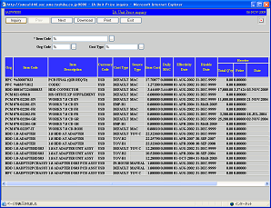
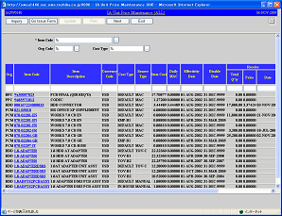
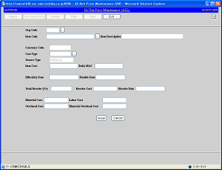
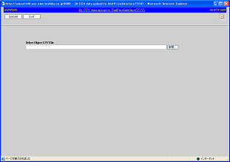
Function Overview
Unit price inquiry and maintenance
Unit price inquiry and maintenance, upload function are provided in IA system.
All kind of unit price can be registered and updated.
The following items should be registered into unit price.
Inventory Organization, Item Code, Price Type, Cost
Cost elements of TOV (Material Cost、Labor Cost, Overhead Cost)
Unit price upload function can be used for TOV and IN-HOUSE and EMP.
After uploading, unit price import process should be executed.
Unit price data can be downloaded as CSV、PDF file.
Inquiry
Unit Price Inquiry
Inquiry, Registration, Update
Unit Price Master
Unit Price
Interface
Unit Price Import Process
Unit Price Maintenance
Registration and Update
Download
Unit Price Upload
Upload

Slide 15
Function Overview
Transaction detail and summary creation
Inventory transaction in Oracle INV and Manual adjustment transaction in IA for current account month are retrieved.
Receiving unit price and cost unit price are retrieved, and transaction amount is calculated.
Receiving price is exchanged to functional currency using daily rate in Oracle GL.
Account code for debit and credit side of Journalization is retrieved from Transaction and account code conversion master.
Transaction detail is created in IA based on retrieved information.
It is grouped and summarized by each transaction date and transition type, item code, sub-inventory.
Exceptional Case ➔ Receiving and Returning, Completion, Shipping transaction are not summarized.
If unit price and account code and so on can not be retrieved, transaction error information is generated without IA transaction detail creation.
IA manual adjustment transaction
Transaction
Error
Creation
IA transaction detail
IA transaction summary
Oracle INV Inventory transaction
Account Month
Account Month
Account Month
Item Code
Item Code
Item Code
Transaction Taking
Unit
Price
Taking
Account
Code
Taking
Transaction
Error
Information
Creation
Transaction Type
Summary- zation
Transaction Type
Transaction Type
Transaction Quantity
Transaction Quantity
Transaction Quantity
Destination sub-inventory
Destination sub-inventory
Destination sub-inventory
Source sub-inventory
Source sub-inventory
Transaction Amount
Transaction Amount
Source sub-inventory
Receiving Price : Oracle PO Receiving Transaction Cost Price : IA price master
Destination Account Code
Destination Account Code
Source Account Code
Source Account Code
Notes:
Skip(explain in Application Flow KT)

Slide 16
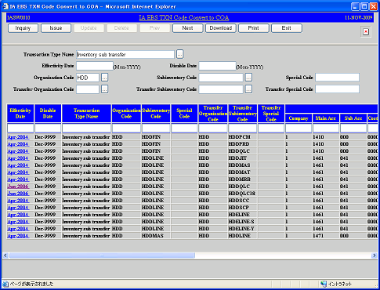
Function Overview
Transaction and account code convert master maintenance
Transaction and account code convert master can be inquired and registered.
Necessary account code is specified by each transaction type and sub-inventory.
The following items should be registered into Master.
Effective and disable month
Transaction type name for source and destination
Inventory Organization for source and destination
Sub-inventory for source and destination
Account code combination for source and destination
The data can be downloaded as CSV and PDF file.
Ex. Transaction and account code convert master data
Effective month |  | Oct-2014
Disable month |  | Dec-9999
Transaction type name |  | Subinventory Transfer
Destination inventory organization |  | HDD
Destination sub-inventory |  | HDDMAT
Source inventory organization |  | HDD
Source sub-inventory |  | HDDLINE
Destination account code | Legal Entity | T090593
 | SBU | M10
 | Site | L10
 | Cost Center | 4002510
 | Natural account | 11601110
 | Sub account | 0000
 | Product Category | X2110
 | Region | PHL
 | Affiliated | 0000000
 | Future1 | 00000
 | Future2 | 0000
Source account code | Legal Entity | T090593
 | SBU | M10
 | Site | L10
 | Cost Center | 4002510
 | Natural account | 11501110
 | Sub account | 0000
 | Product Category | X2110
 | Region | PHL
 | Affiliated | 0000000
 | Future1 | 00000
 | Future2 | 0000
Transaction and Accounting Code
Convert Master
Download
Transaction and Account Code Convert Master Maintenance

Slide 17
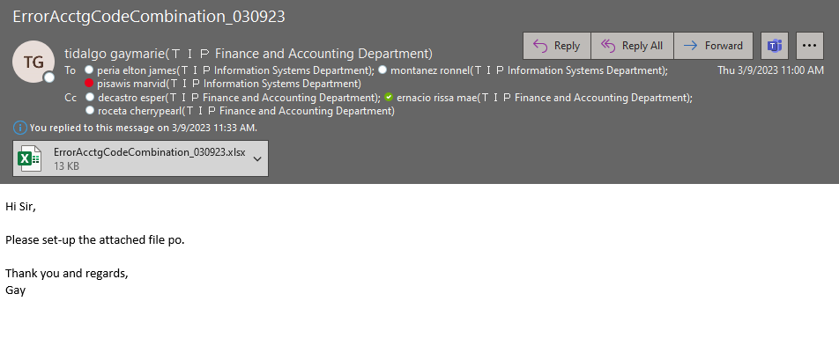

Slide 18
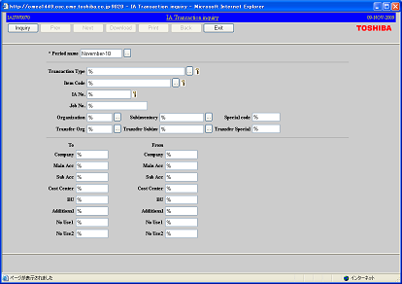
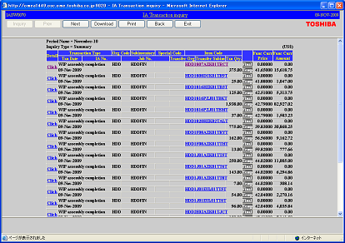
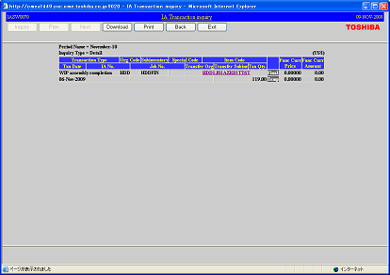
Function Overview
Transaction Inquiry
Transaction summary data can be inquired by specifying detail search criteria.
Transaction detail can be accessed from transaction summary.
Also past data within retention period can be inquired.
Inquired data can be downloaded as CSV and PDF file.
Transaction
Summary
Transaction
Summary
History
Search Criteria Input
Search Result of
Transaction Summary
Transaction
Detail
Transaction
Summary
Detail
Download
Search Result of
Transaction Detail
Notes:
Transaction inquiry
Transaction data, we can inquiry by screen

Slide 19
Function Overview
Example of inventory balance update
Example 1
Transaction
Item | Transaction | Dest. Sub-inventory | Source Sub-inventory | Qty. | Amount
Parts-A | Stock Transfer | HDDLINE | HDDMAT | 2,000 | $10,000
Inventory Balance (Before update)
Item | Sub-inventory | Normal receipt |  | Transfer receipt |  | Normal issue |  | Transfer issue |  | Inventory
 |  | Qty. | Amount | Qty. | Amount | Qty. | Amount | Qty. | Amount | Qty. | Amount
Parts-A | HDDMAT | 0 | 0 | 0 | 0 | 0 | 0 | 0 | 0 | 0 | 0
Parts-A | HDDLINE | 0 | 0 | 0 | 0 | 0 | 0 | 0 | 0 | 0 | 0
Inventory Balance (After update)
Parts-A | HDDMAT | 0 | 0 | 0 | 0 | 2,000 | 10,000 | 0 | 0 | 0 | 0
Parts-A | HDDLINE | 2,000 | 10,000 | 0 | 0 | 0 | 0 | 0 | 0 | 2,000 | 10,000
Example 2
Transaction
Item | Transaction | Dest. Sub-inventory | Source Sub-inventory | Qty. | Amount
Parts-A | Misc. Issue | HDDLINE |  | 500 | 2,500
Parts-A | Back-Flush | HDDLINE |  | 1500 | 7,500
Inventory Balance (Before update)
Item | Sub-inventory | Normal receipt |  | Transfer receipt |  | Normal issue |  | Transfer issue |  | Inventory
 |  | Qty. | Amount | Qty. | Amount | Qty. | Amount | Qty. | Amount | Qty. | Amount
Parts-A | HDDMAT | 0 | 0 | 0 | 0 | 2,000 | 10,000 | 0 | 0 | 0 | 0
Parts-A | HDDLINE | 2,000 | 10,000 | 0 | 0 | 0 | 0 | 0 | 0 | 2,000 | 10,000
Inventory Balance (After update)
Parts-A | HDDMAT | 0 | 0 | 0 | 0 | 2,000 | 10,000 | 0 | 0 | 0 | 0
Parts-A | HDDLINE | 2,000 | 10,000 | 0 | 0 | 1500 | 7,500 | 500 | 2,500 | 0 | 0
Notes:
省略

Slide 20
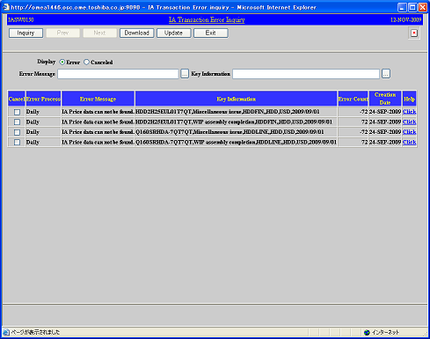
Function Overview
Transaction error inquiry and maintenance
If transaction taking and balance update can not be performed due to the following reason, transaction error is generated.
Recovery treatment can be executed by referring this transaction error information.
Additionally, transaction taking can be canceled if treatment is not necessary.
Error Message | Error Content
IA Price data can not be found | Cost unit price (DEFAULT) is not registered into IA price master.
PO Price can not be found | Receiving transaction does not have receiving price.
Accounting code can not be found | Corresponding setup data is not registered in transaction and account code convert master.
Exchange rate can not be found | Daily exchange rate is not GL daily rate master.
Amount error for manual transaction entry | Amount in IA manual adjustment transaction is Zero or Blank.
Transaction Error Information
Download
Check and Chancel

Slide 21
Function Overview
Transaction data GL connection
Executed once a month in monthly processing.
Based on the IA transaction summary, group and summarize journal data by account month, transaction type, account item, and amount sign, and connect to GL. If the amount sign of the IA transaction is negative, the accounts are reversed by credit and debit, and journal data is created with a positive amount.
For completion, create journal data by breaking down by TOV cost element.
(DR)Item-Material Cost / (CR)Item (DR)Item-Labor Cost / (CR)Item (DR)Item-Overhead Cost / (CR)Item
Completion cancellation is the reverse journal
PO Receipt/Return to Vendor not connect.
Transaction Type Name | Connect target
PO Receipt | -
Return to Vendor | -
Subinventory Transfer | ✔
Direct Org Transfer | ✔
WIP Completion | ✔
WIP Completion Return | ✔
WIP Issue | ✔
WIP Return | ✔
Sales Order Shipment | ✔
Sales Order Shipment Return | ✔
Miscellaneous issue | ✔
Miscellaneous receipt | ✔
xxx Interdept expense transfer | ✔
Physical Inv Adjust | ✔
Revaluation cost | ✔
TOV change cost | ✔

Slide 22
END

